Slide 1
Liquidity Management in MSMEs (Liquidity is the Key) | By CA Maheshwar Marathe Pune

Slide 2
Introduction
MSME = Micro, Small & Medium Enterprises
Popularly know as SMEs or SSIs
These are Manufacturing & Service units (Trading included for PSE).
Mudra, Startup, Stand up, Loan Restructuring, Interest subvention - all for MSMEs.

Slide 3
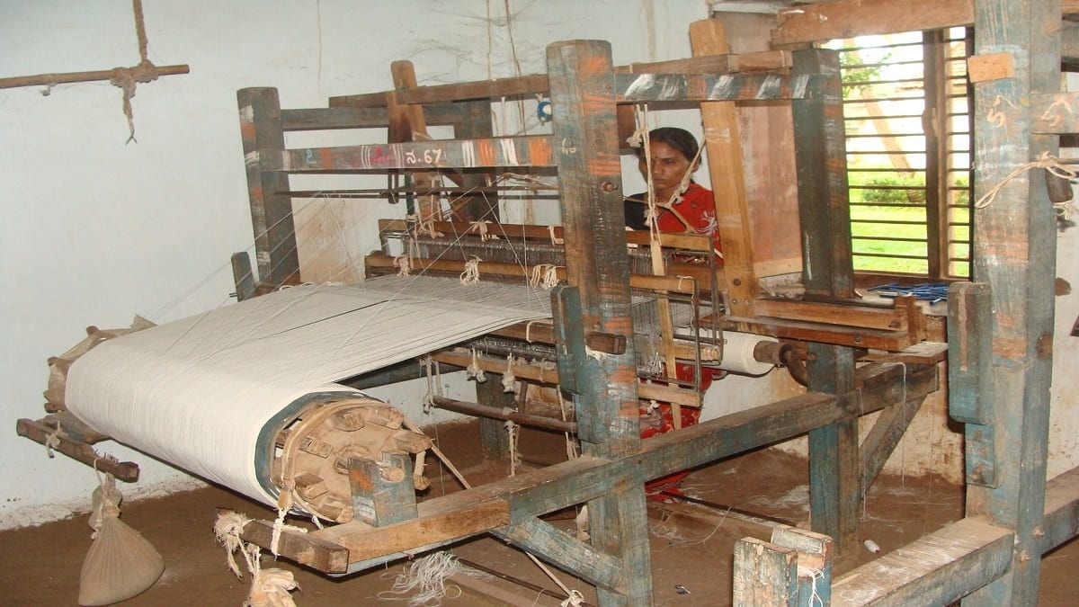
Strength…
7 crores units which include
Home, cottage, village, tiny units (69%)
15 cr + workforce, Second biggest after Agri.
6,000+ products
Contributes about 30% to GDP, 45% to the total manufacturing output and 40% to the exports
They are backbone of economy, the priority sector, close to the Govt.

Slide 4
MSMED Act
Y
E
S
CMEGP
Cluster
GeM
TReDS
How do I fund new Orders?
How do I increase my business?
PLI
59 Min
TU
Are there any incentives?
How do I Manage Credit Period?
Samadhaan
PSI
Startup India
Sub Debt
I am a MSME

Slide 5
Formalization process of MSME Sector
2003
2023
Formation of MSME Ministry 2003
MSMED Act 2006
Categorization – Micro, Small, Medium
Regulating the Credit Period/liquidity
New definition 2020
Simplified Registration process 2015
Regulating the dispute resolution
Formation of councils
Enabling provisions
MCA circular on reporting of MSME o/s
MSME circular to 500 Cr + Corps
Audit Reporting

Slide 6
MSME - Old definition
Type of Unit | Manufacturing | Service
 | P&M | Equipment
Micro | 25 Lk | 10 Lk
Small | 5 Cr | 2 Cr
Medium | 10 Cr | 5 Cr

Slide 7
New Definition of MSME – w.e.f - 1st July, 2020
Manufacturers & service providers | MICRO | SMALL | MEDIUM
Investments in Plant & Machinery or Equipment | Upto Rs. 1 crore | Upto Rs. 10 crores | Upto Rs. 50 crores
Turnover | Upto Rs. 5 crores | Upto Rs. 50 crores | Upto Rs. 250 crores

Slide 8
The change
Definition (Limits) changed after 14 long years. .
Earlier, amendments to MSMED Act were proposed 2 times in 2015 and 2018 – could not be notified
Increased limit of Invt in Plant & Machinery (4 Times for Mnf to 10 times for Services)
Added criteria linked to Turnover
No distinction between Manufacturer & Service Provider.
Almost 99% of entities will now be MSME, only 1% to be large.

Slide 9
Registration Process
IS NOW
www.udyogaadhaar.gov.in
www.udyamregistration.gov.in
30th June 2022 – last date

Slide 10
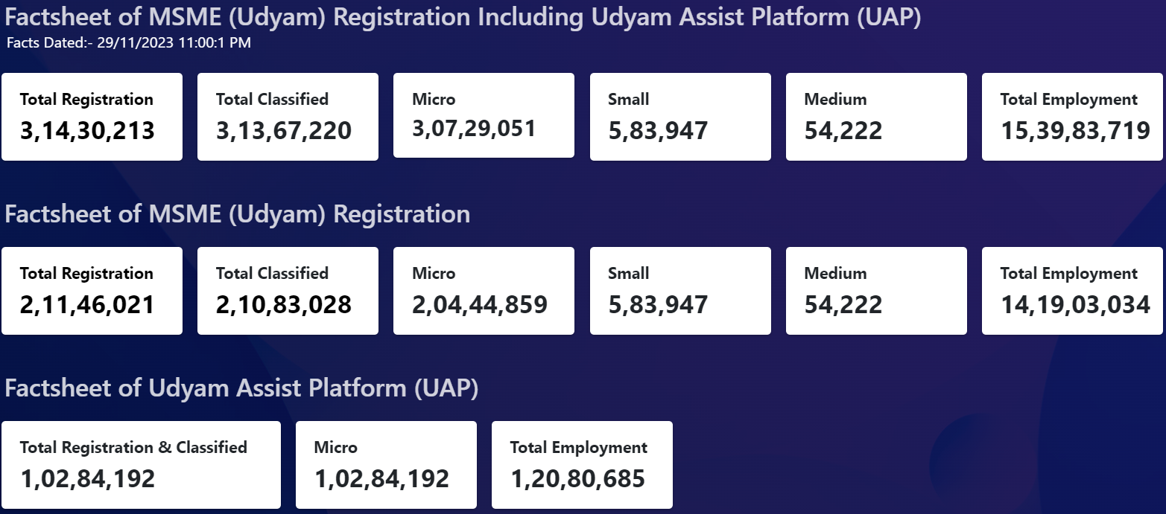

Slide 11
NIC - 2008
Activities are first grouped into ‘section’ alphabetically coded from A - U
Every section is divided into ‘division’ with 2-digit numeric code
Every division into ‘group’ with 3-digit numeric code
Every group into ‘class’ with 4-digit numeric code and
Every 4-digit class into 5-digit ‘sub-class’.
Division | 23 | Manufacture of other non-metallic mineral products
Group | 239 | Manufacture of non-metallic mineral products
Class | 2394 | Manufacture of cement, lime and plaster
Subclass | 23945 | Manufacture of plasters of calcined gypsum or calcined sulphate

Slide 12
Calculation of Investment and turnover
Investment: Same as IT Act, include all Tangible Assets (other than Land & Building, Furniture & Fixture). Taken at WDV
Turnover - Export of Goods or Services excluded.
Investment and Turnover Linked to Income Tax Act /CGST Act and GSTN.

Slide 13
Transition
Re-classification: Graduation, lower to higher category or visa versa.
Base year
Effectiveness
Upward change
Will maintain its prevailing status till expiry of ONE year from close of year. Benefits continue THREE yrs post change
Reverse Graduation
Will continue in its present category till the closure of F.Y.

Slide 14
Very Important to Note (For CA Certificate)
All units with GSTIN listed against same PAN shall be clubbed & collectively treated as one enterprise.
Turnover and investment figures for all of such entities shall be aggregated
Only aggregate values considered for deciding the category as Micro, Small Or Medium Enterprise.

Slide 15
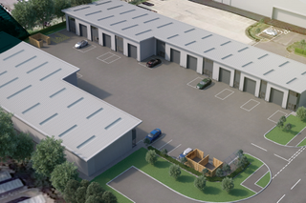
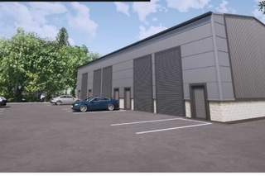
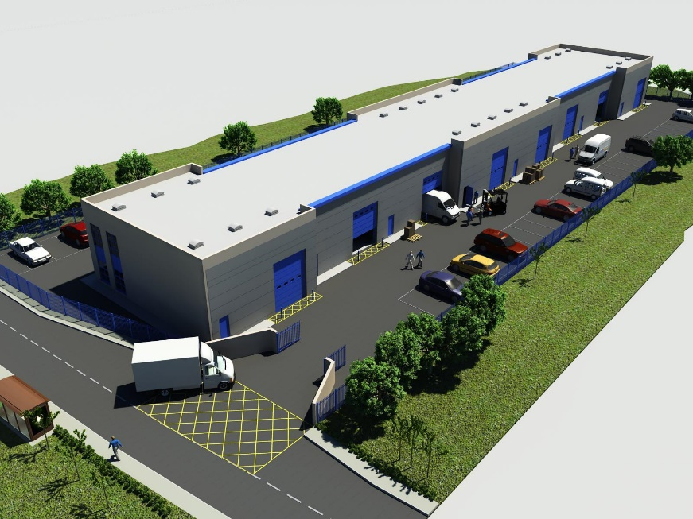
Belagavi
One PAN = One URN
Multiple Units, Multiple Activities
=
One URN
Pune
Chennai
Bangalore

Slide 16
Liquidity Solutions

Slide 17
S15: Buyers Liability to make Payment
Where any supplier supplies any goods/services, the buyer shall make payment thereof on or before the date agreed upon between him and the supplier in writing.
Where there is no agreement in this behalf, before the appointed day;
In no case the period agreed upon between the supplier and the buyer in writing shall exceed forty-five days from the day of acceptance or the day of deemed acceptance.

Slide 18
Credit period interpreted
Appointed Day, Day of Acceptance, Day of Deemed Acceptance
SN | Scenario | Deciding date | Payable within (days) | Credit Period
S 1 | No agreement, no Query | Day of delivery (deemed acceptance) | 15 of delivery | 15
S 2 | No agreement, but Query | Day of acceptance (15 days from delivery) | 15+15 days i.e. 30 days from delivery | 30
S 3 | Agreement, but no Query | Max 45 days from delivery | 45 days of delivery | 45
S 4 | Agreement & Query | Max 45 Days from deemed acceptance (15 days from delivery) | 15 days+ 45 days | 60

Slide 19
S16: Interest on Delayed Payments
Where any buyer fails to make payment to the supplier as per Section 15 – he is liable to pay Compounded interest with monthly at three times of the bank rate
Present Bank rate – 6.75% hence ROI u/s 16 is 20.25%
COMPANY | 20-21 |  | 21-22 |  | 22-23 |  | Total
 | Delayed Amt | Interest | Delayed Amt | Interest | Delayed Amt | Interest
TATA Motors | 186 | 4.6 | 344 | 5.44 | 193 | 7.05 | 17.09
M&M | 412 | 0.9 | 640 | 5.54 | 466 | 4.62 | 10.92
BAJAJ Auto | 0 | 0 | 0 | 0 | 0 | 0 | 0.0

Slide 20
Section 43B (23-24)
(h) any sum payable by the assessee to a Micro Or Small Enterprise beyond the time limit specified in section 15 of MSMED Act - shall be allowed only in computing the income referred to in section 28 of that previous year in which such sum is actually paid by him
Provided that nothing contained in this section shall apply in relation to any sum which is actually paid by the assessee on or before the due date of ITR except for clause (h)

Slide 21
Disclosure u/s 22
Any buyer required to get his accounts audited under any law for the time being in force, such buyer shall furnish the 5 point info in his annual statement of accounts,
SN | PARTICULATS | Principal Amt. RS. | Interest Amt. Rs.
1 | Interest & Principal paid beyond due date (During the year) | 800000 | 100000
2 | Interest & Principal o/s (Year end) | 1600000 | 150000
3 | Interest due for Principal paid beyond due date (Out of 2 above, but relating to 1 above) | - | 80000
4 | Balance Interest accrued for Principal unpaid (2-3) | - | 70000
5 | Status of Interest up to reporting date (As on date of signing of balance sheet) | - | 40000

Slide 22
Penalties
Penalty for contravention of section 8 or section 22 or section 26.
(1) Whoever intentionally contravenes provisions of section 8(1) [Filing of EM/Udyam], 26(2) – [Furnishing of info] shall be punishable—
First conviction with fine which may extend to Rs. 1000; and
Second or subsequent conviction, shall not be less 1000, max 10000
(2) Where a buyer contravenes the provisions of section 22, he shall be punishable with fine which shall not be less than rupees 10000

Slide 23
Companies Act
All companies with a turnover > Rs. 500 crore and all Central PSEs shall be required to get themselves on boarded on the Trade Receivables Discounting System platform, set up as per the notification of RBI. (MCA Notif Nov 2018)
All companies, who get supplies of goods or services from MSEs and whose payments to them EXCEED FORTY FIVE DAYS from the date of supply as per the provisions of section 9 of the MSMED Act - hereafter referred to as “Specified Companies”, shall submit the info in on Half yeaForm MSME-1 rly basis (MCA Notif Jan 2019)

Slide 24
Schedule III amendment – 1st April 2021
Trade Payables: (A) total outstanding dues of micro & small Entp; and (B) total outstanding dues of creditors other than micro & small Entp.
Additionally, following ageing schedule shall be given

Slide 25
Income Tax Act
Clause 22 of 3CD - Amount of interest inadmissible under section 23 of MSMED Act 2006
Identify the MSE suppliers
Verify if credit period is < 45 days
If there is delay whether entity has provided interest
If Yes – Report the same
If not – Reporting? Mention NIL

Slide 26
Audit Procedure
Documentation of verification process adopted “to verify how auditee has identified its MSE suppliers”.
Correspondence with suppliers, replies received?
If a supplier has printed his udyam on invoice - straight way classify.
Any claim is received through SAMADHAAN?
Audit conclusion on findings & Reporting of non compliance
No identification procedure done – Qualify.
Procedure done MSEs identified but no interest provided - Qualify
MSEs identified and Interest provided – Compliance done.
MRL - NIL MSEs identified, Total delay in payment, Interest provision and calculation thereof.

Slide 27
DISPUTE RESOLUTION by MSE Facilitation Council
How do I Manage Credit Period?

Slide 28
Recovery related DISPUTE?
Approach the buyer
SAMADHAAN
Under MSME Act-2006
PAYMENT
NOT
RECE
I
VED
PAYMENT
RECE
I
VED
MSME Samadhaan
E
ND
FC Hearing
Execution petition

Slide 29
TReDS
How do I fund new Orders?
TReDS is an electronic platform facilitating the financing of trade receivables of MSMEs through multiple FIs. These receivables can be due from corporates and other Buyers, including Govt. Depts & PSUs.

Slide 30
TReDS - FAQ
How do I fund new Orders?
? Whether the MSME liable to pay to the financier in case the buyer defaults in repayment?
Ans: No. The transactions processed under TReDS are “without recourse” to the MSMEs.
? Are there charges for registration?
Ans: No, all three platforms have free registration facility.
? Is this compulsory for all buyers
Ans: Its compulsory for all PSU and corporates with turnover > 500 Crores

Slide 31
RXIL INVOICE MART M1XCHANGE
How do I fund new Orders?
TReDS platforms business
FY – 2020 - 11.17k cr
FY – 2021 - 17.08k cr
FY – 2022 - 40.3k cr
FY – 2023 - 150k cr+

Slide 32
How do I increase my business?
GeM
Government E Marketplace

Slide 33
GeM need..
How do I increase my business?
Manual Public Procurement Policy has manual intervention, complex policies and long lead times.
GeM is an online, end-to-end marketplace reform that provides an open, efficient & transparent solution.
Mandatory purchase of 25% from MSMEs.
Sub target 4% MSMEs SC/ ST communities.
www.gem.gov.in

Slide 34
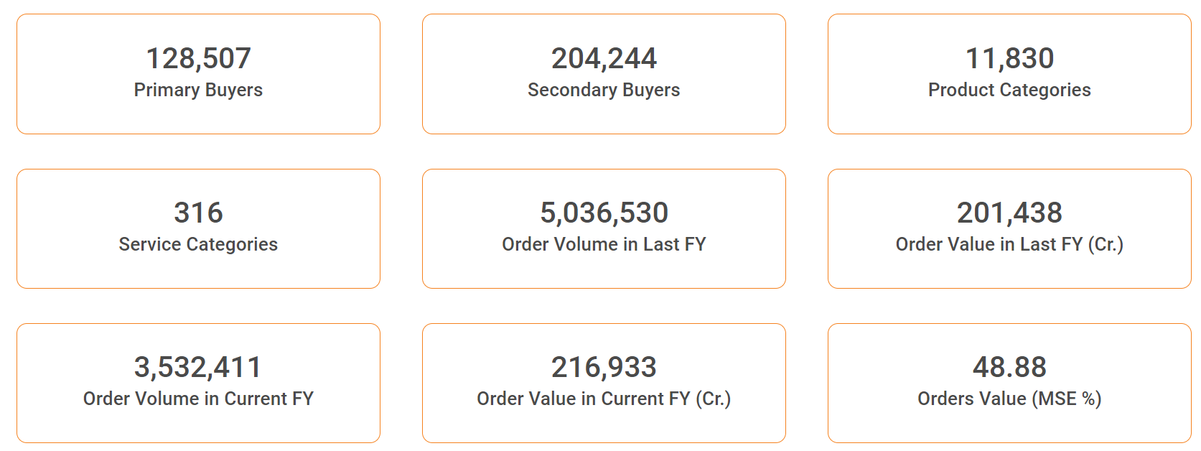
GeM stat..
Opportunity
34 Lac Crore - India's annual public procurement
7 Lac Crore - Cumulative proc till date
100% target in 3 years

Slide 35
Incentives
Are there any incentives for me?
PSI – State subsidy scheme
MAHA Women Entrepreneurship policy.
Cluster – CFC
PLI – Production linked incentive
SPECs
59 minutes
MSME Lean

Slide 36
Cluster
CFC
MSE-CDP

Slide 37
Cluster - Purpose
To competitiveness and growth of MSEs by addressing common issues such as improvement of technology, skills & quality, market access, etc.
To create / upgrade infrastructural facilities in the new / existing Industrial Areas / Clusters of MSEs.
To set up Common Facility Centres (for testing, training, raw material depot, effluent treatment, complementing production processes).
Promotion of green & sustainable manufacturing technology

Slide 38
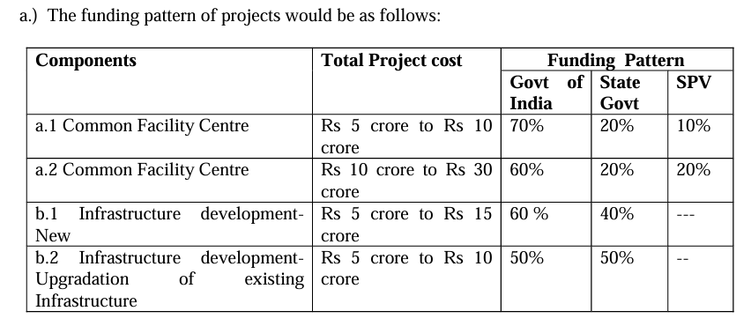
Incentive

Slide 39
Scheme for Promotion of Manufacturing of Electronic Components and Semiconductors
SPECS

Slide 40
SPECS

Slide 41
Circular Economy - Recycling
Recycling facility for extraction of minerals (rare earth elements, lithium, niobium, palladium, cobalt, tantalum, ruthenium etc.);
Any or few or all of the precious metals (gold, platinum, palladium, silver)
Base metals (copper, aluminum, nickel, tin, zinc, iron, cobalt, tantalum etc.) or their compounds from e-waste components, including PCBs
any other components from e-waste, and also from intermediary products (like black mass, black copper etc.) extracted from e-waste".
Threshold Investment = Rs. 2 cr

Slide 42
MSME Lean

Slide 43
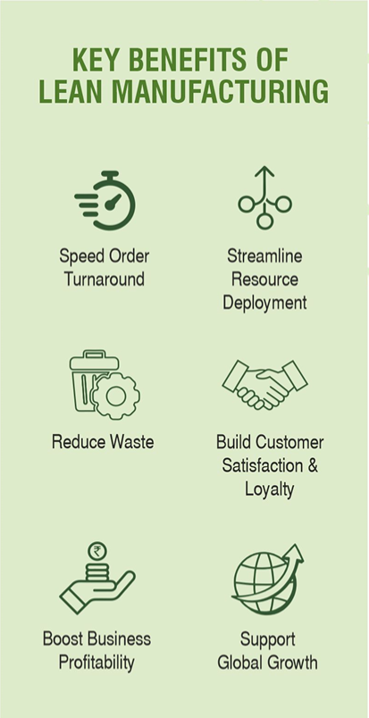
MSME - LEAN
Lean is an intentionally acknowledged process to transform an organization to be competitive and profitable by reducing waste.
LEAN provides optimum use of manpower and machines, helps in identifying & correcting errors at the right time to increase quality, productivity, safety and ultimately profit.

Slide 44
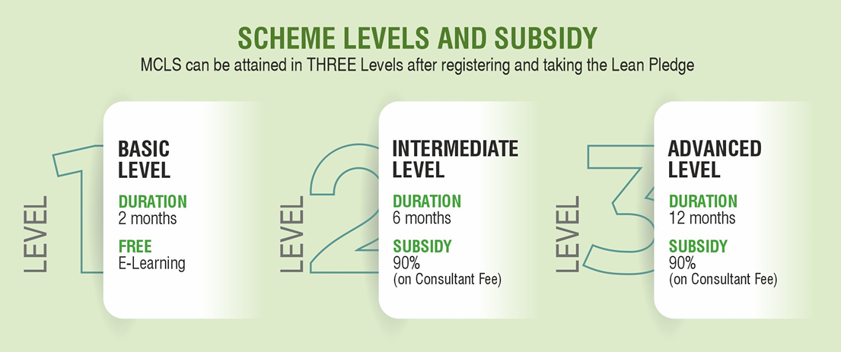

Slide 45
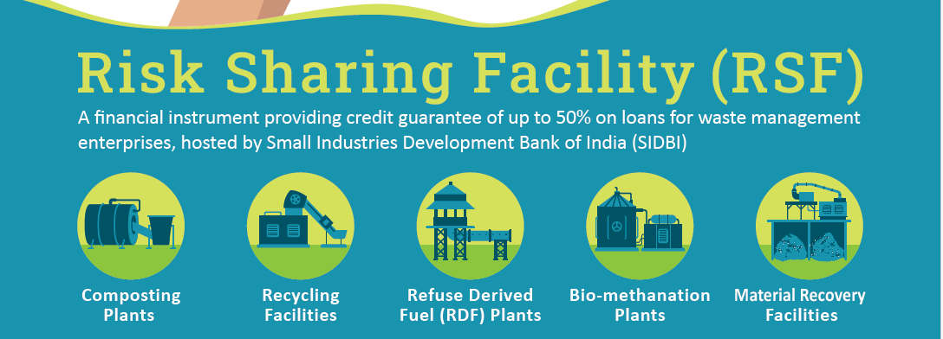
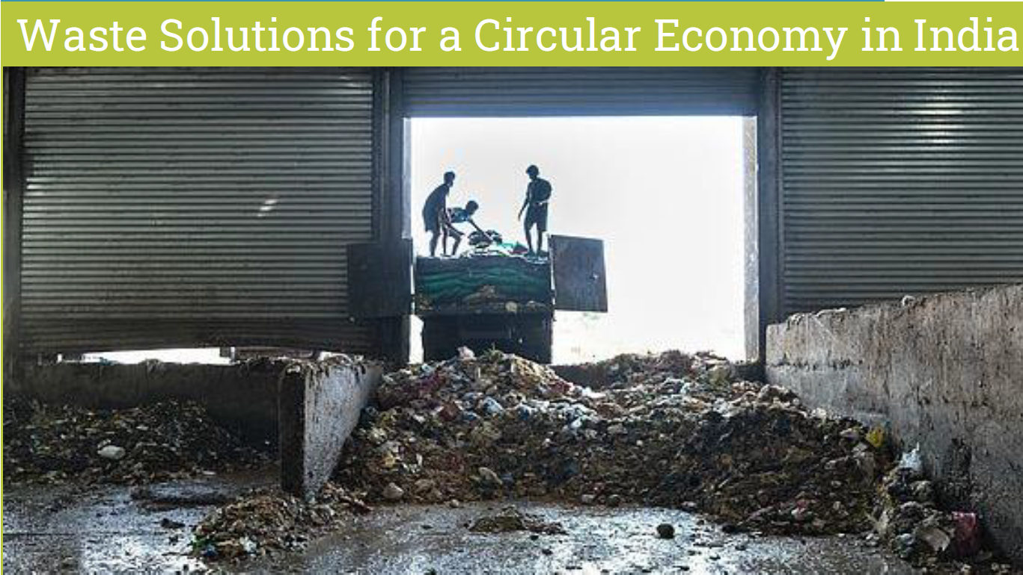
Waste Management Enpts
Debt Guarantee on
Term loans - For capex
Working capital loans - Fund Based and Non-Fund Based

Slide 46
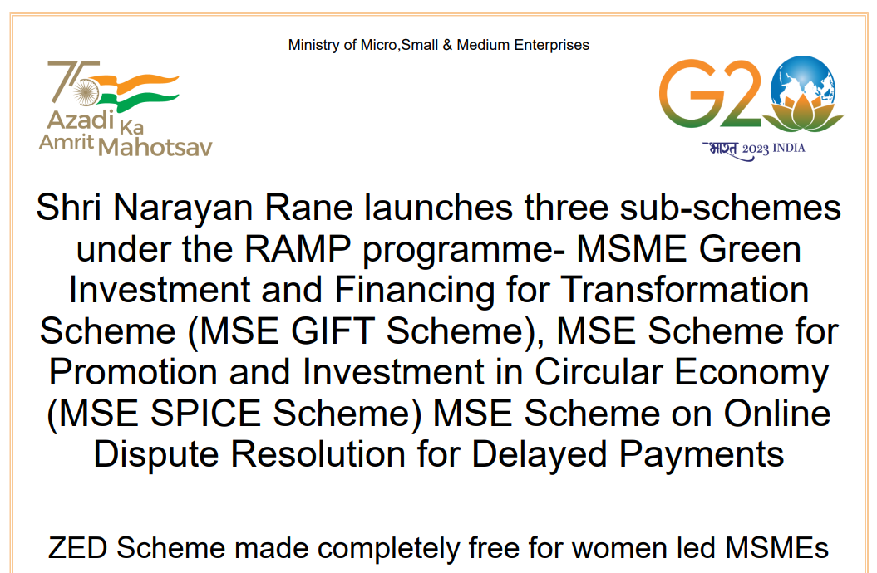

Slide 47
Highlights
The MSME Green Investment and Financing for Transformation Scheme (MSME GIFT) to help MSMEs adopt green technology with interest subvention and credit guarantee support.
The MSE Scheme for Promotion and Investment in Circular Economy (MSE SPICE) to support circular economy projects, will be done through credit subsidy. Target zero emissions by 2070.
The MSE Scheme on Online Dispute Resolution for Delayed Payments to synergise legal support with modern IT tools and Artificial Intelligence to address the incidences of delayed payments for MSEs
The Support for Commercialisation of IP Programme (MSME – SCIP Programme) will enable the innovators in the MSME sector to commercialize their IPR.
ZED Scheme of the Ministry has now been made completely free for women led MSMEs.

Slide 48
Better the Liquidity = Best the Profits
A CRISIL study says
if SMEs get paid as per the provisions of MSMED Act (45 days)
their profitability will go up by 15%
Thank you
camarathe@cmrs.in
8055566683

